Slide 1
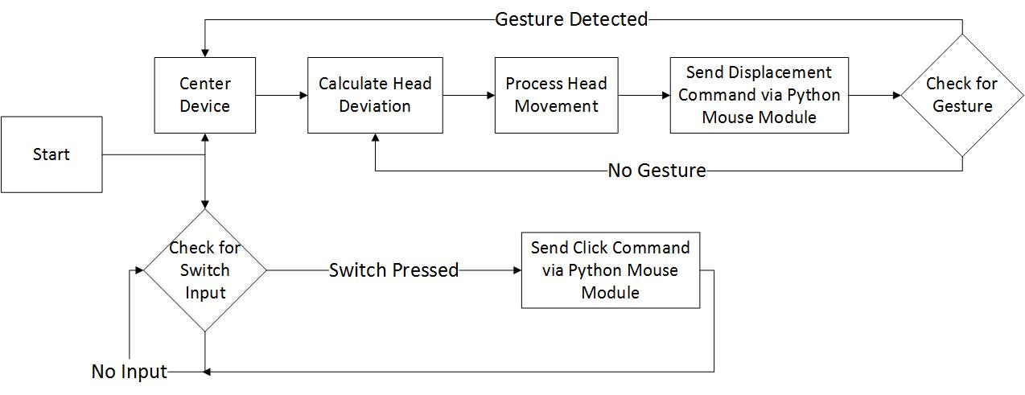
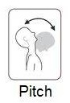
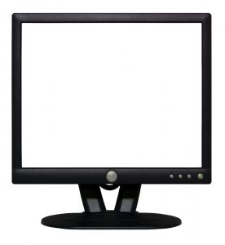
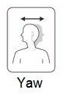

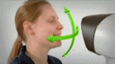
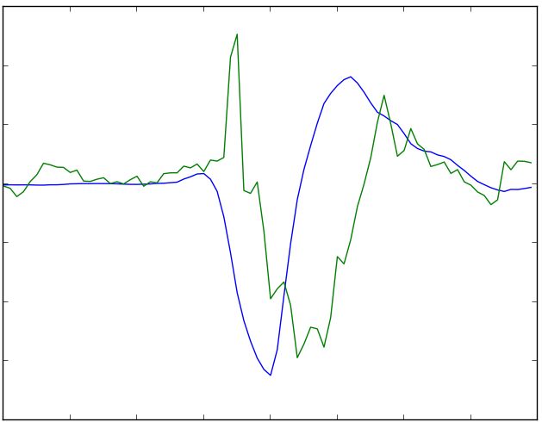
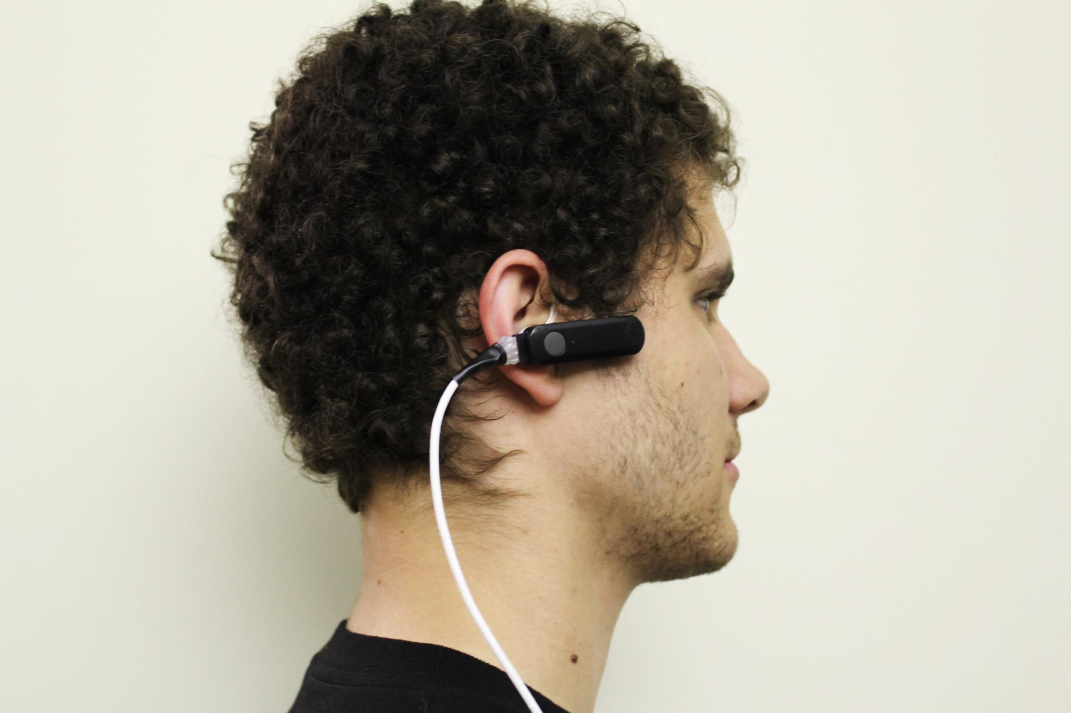
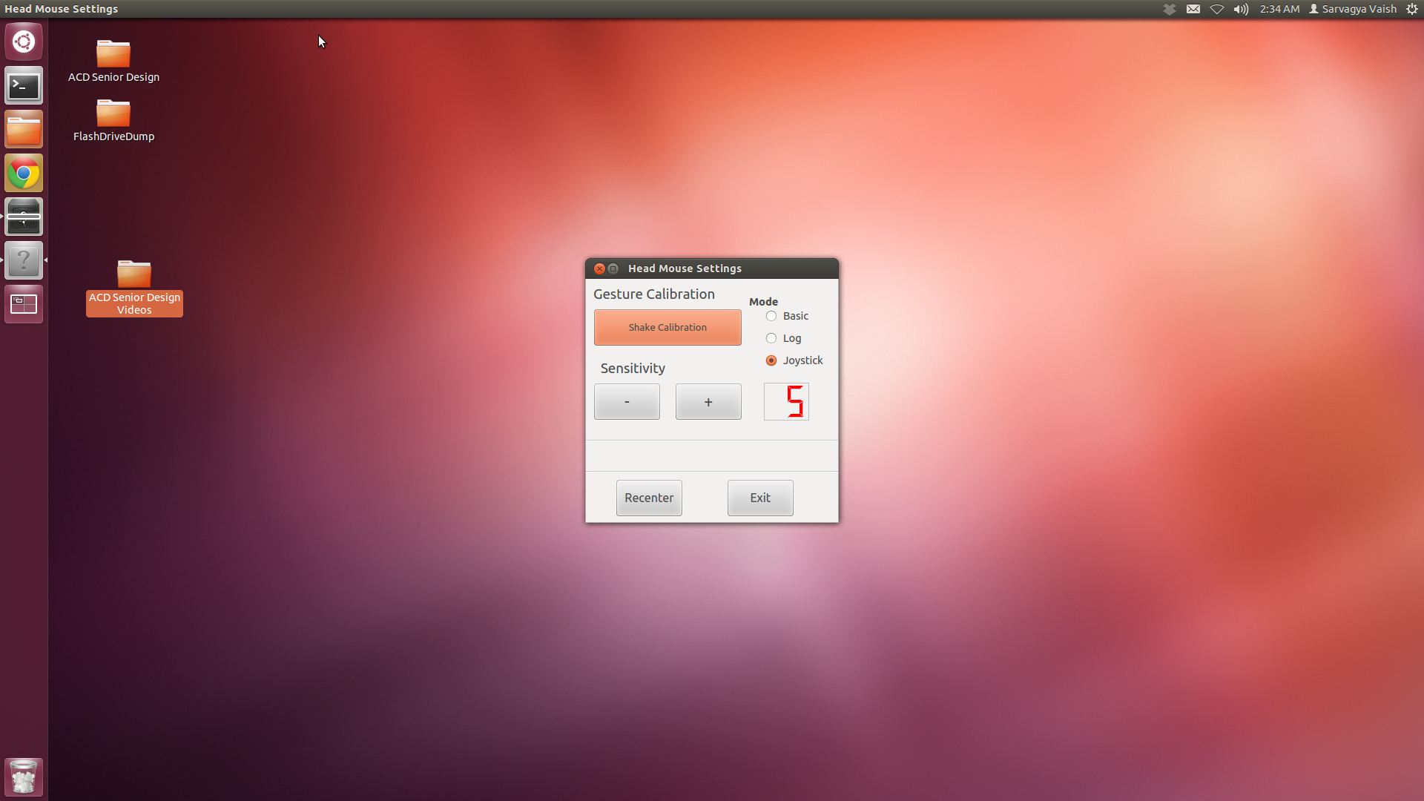
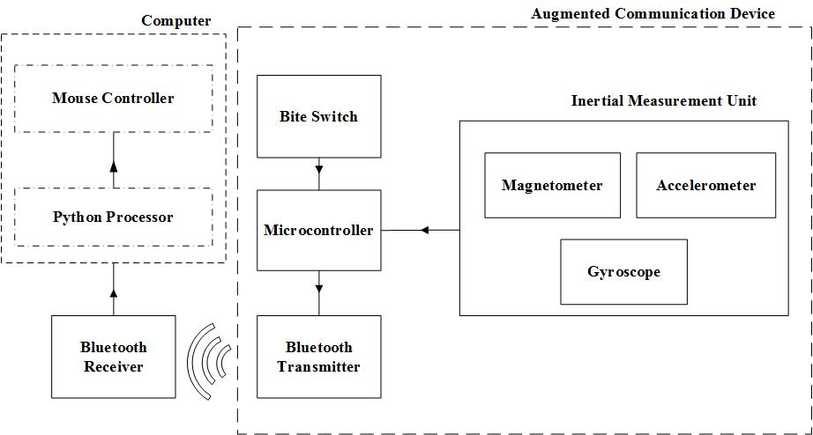
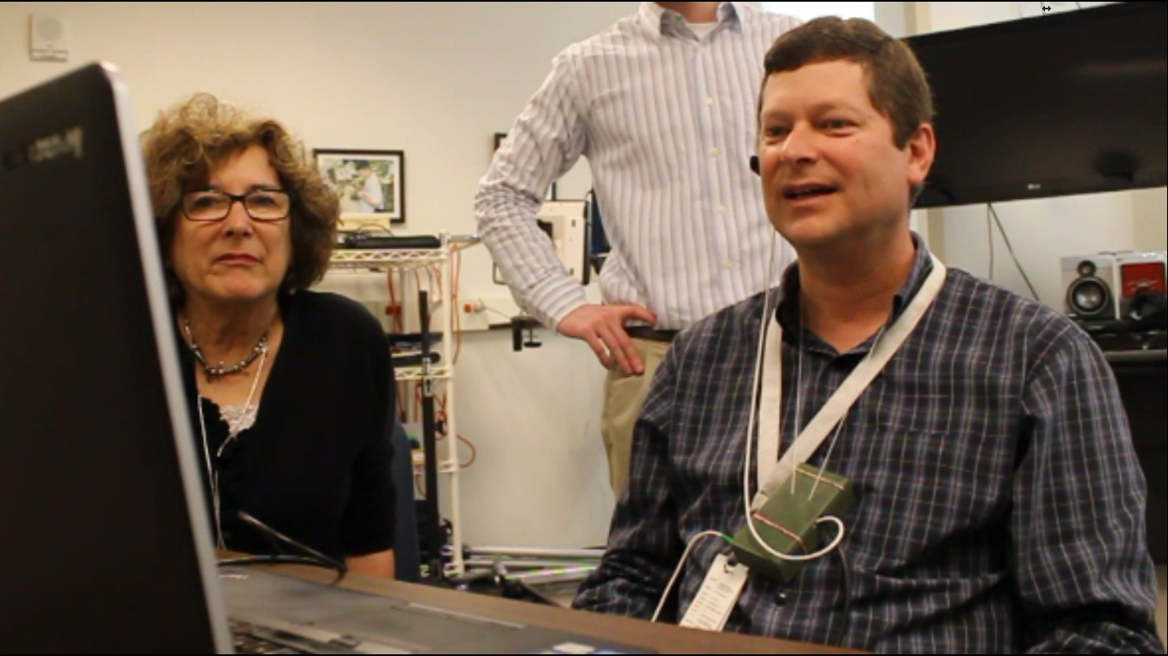
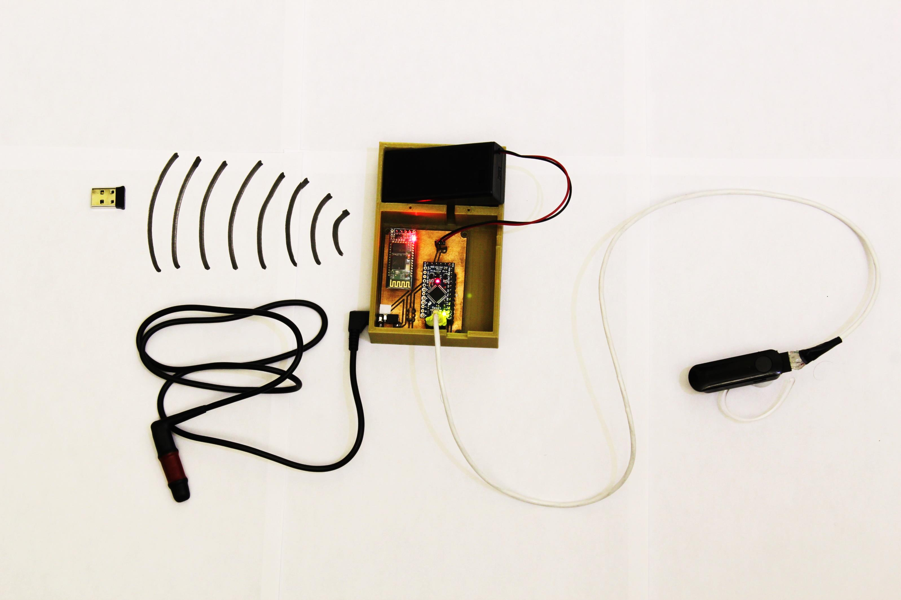
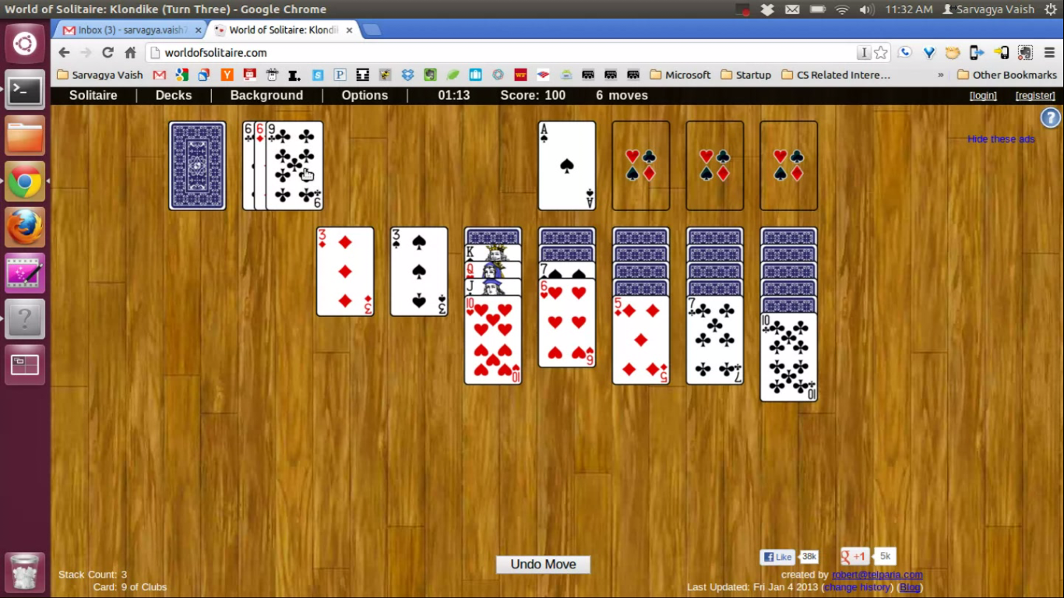


HeadWay – Augmented Communication Device
Roberto Pereira, Seth Stewart, Jarius Tillman, Sarvagya Vaish and Dr. Koblasz Georgia Institute of Technology, Atlanta GA
Objectives
Software
Prototype system to enable patients with spinal cord injury and limited hand mobility, to interface with a computer.
Translate head pitch and yaw movements to computer cursor displacement
Integrate all components into a small wearable lightweight device
Control Flowchart
Gesture Recognition
User Interface
$$\left[\begin{matrix}Accelerometer Data \\ Gyroscope Data \\ Compass Data\end{matrix}\right]$$
Principal Component Analysis (PCA)
Compare movement to gesture data at every time step.
$\left[2 × n\right]$data representing the gesture
Start Gesture Training
Hardware
Adjust Device Sensitivity
Recalibrate Device
Starting up…
Message Panel
Experiments and Results
Dr. John Anschutz, manager of the Assistive Technology Program at Shepherd Center using the HeadWay device.
Battery
Bluetooth Transceiver
The device was tested on a browser version of the game Solitaire.
Arduino
Inertial Measurement Unit
Bite Switch
Contact Information: Sarvagya Vaish, sarvagyavaish@gatech.edu, (404) 654 3664

